Slide 1
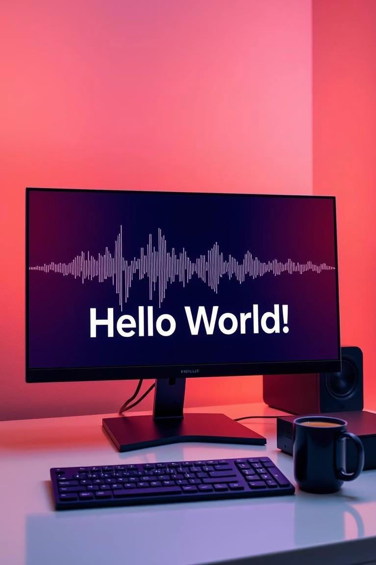
Text-to-Speech & Speech-to- Text Converter Using Python
Presented by Mujtaba, Roll No. 2206, GDC No. 1 DIK.
This project delivers a simple Python converter for TTS and STT.

Slide 2
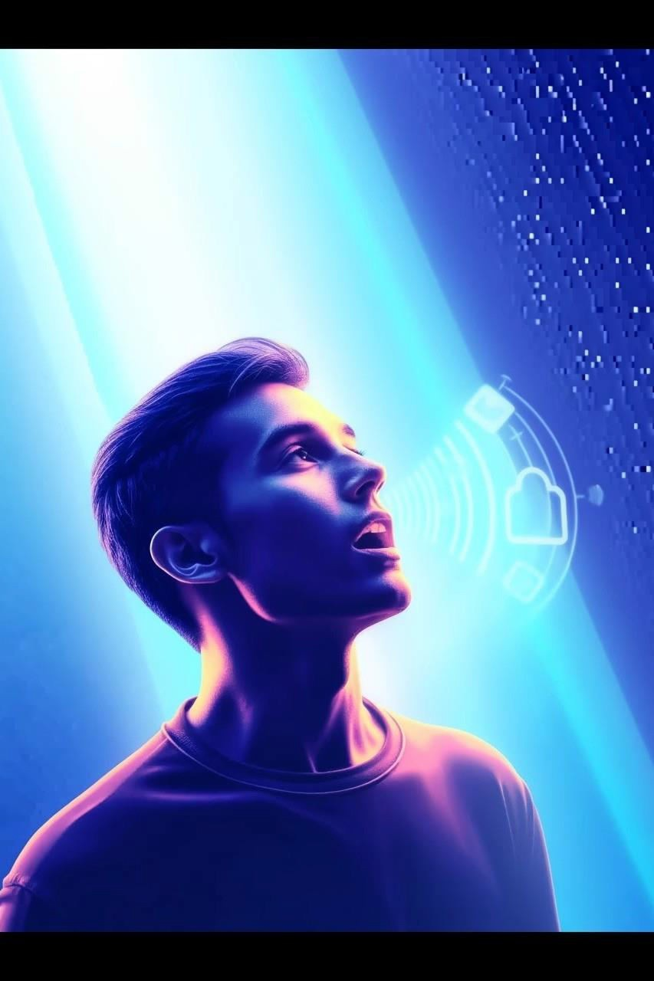


Understanding TTS and STT Technologies
Text-to-Speech (TTS)
Transforms written text into spoken audio for accessibility and automation.
Speech-to-Text (STT)
Converts spoken language into digital text, enabling voice commands and transcription.
Project Goal
Create a user-friendly TTS and STT Python app using essential libraries.

Slide 3
Project Core Components & Libraries
Core Functions
Key Libraries
Text converted to speech Speech transformed back to text
tkinter for UI
gTTS for speech synthesis speech_recognition for audio processing

Slide 4
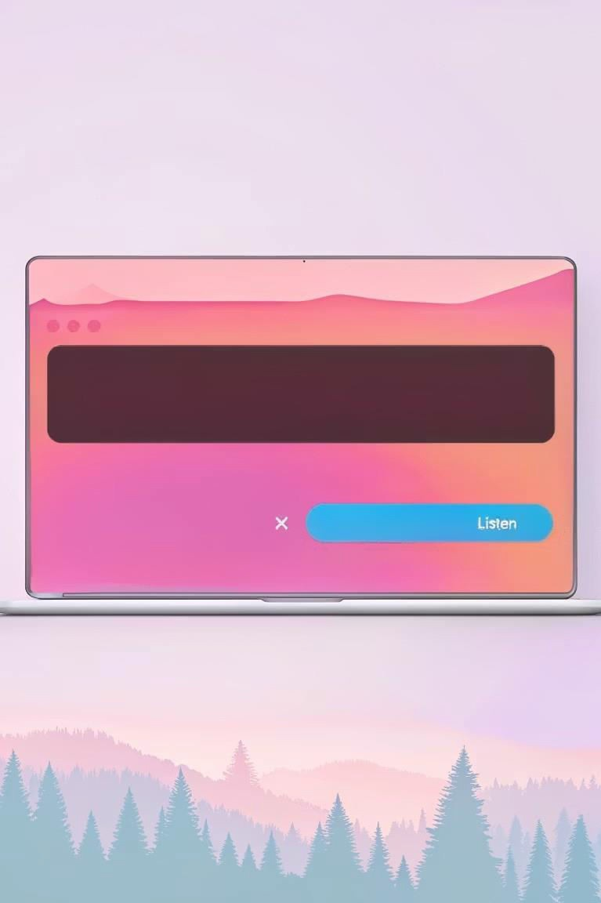



Text-to-Speech Module Design
User Interface
Text input field with a "Listen" button for conversion.
Processing Pipeline
Text processed by gTTS, saved as MP3, then played back.
2
Output
Clear speech audio generated from user input text.

Slide 5
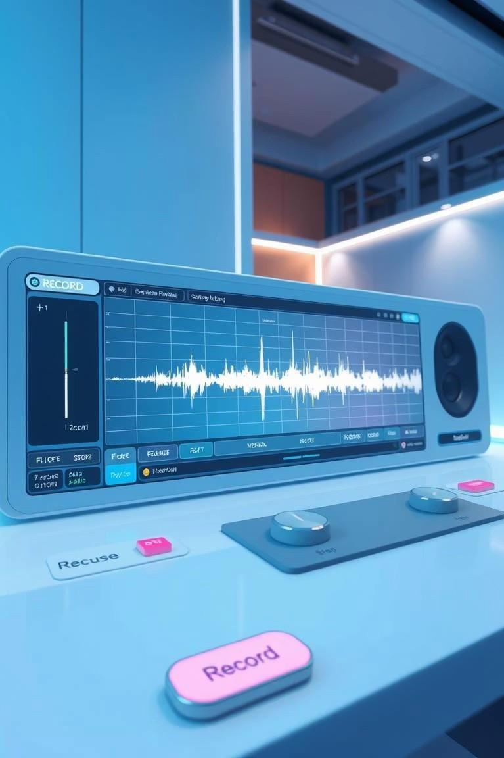
Speech-to-Text Module Insights & Future Directions
Current Process
Microphone records audio, processed using Google's recognition API.
Challenges
Ambient noise and limited language options affect accuracy.
Improvements
Expand language support and enhance noise filtering methods.
Next Steps
Refine UI and integrate additional speech APIs for robustness.

